Slide 1
Music Server
Using Mopidy by: Huilin Chen and Huang Huang

Slide 2
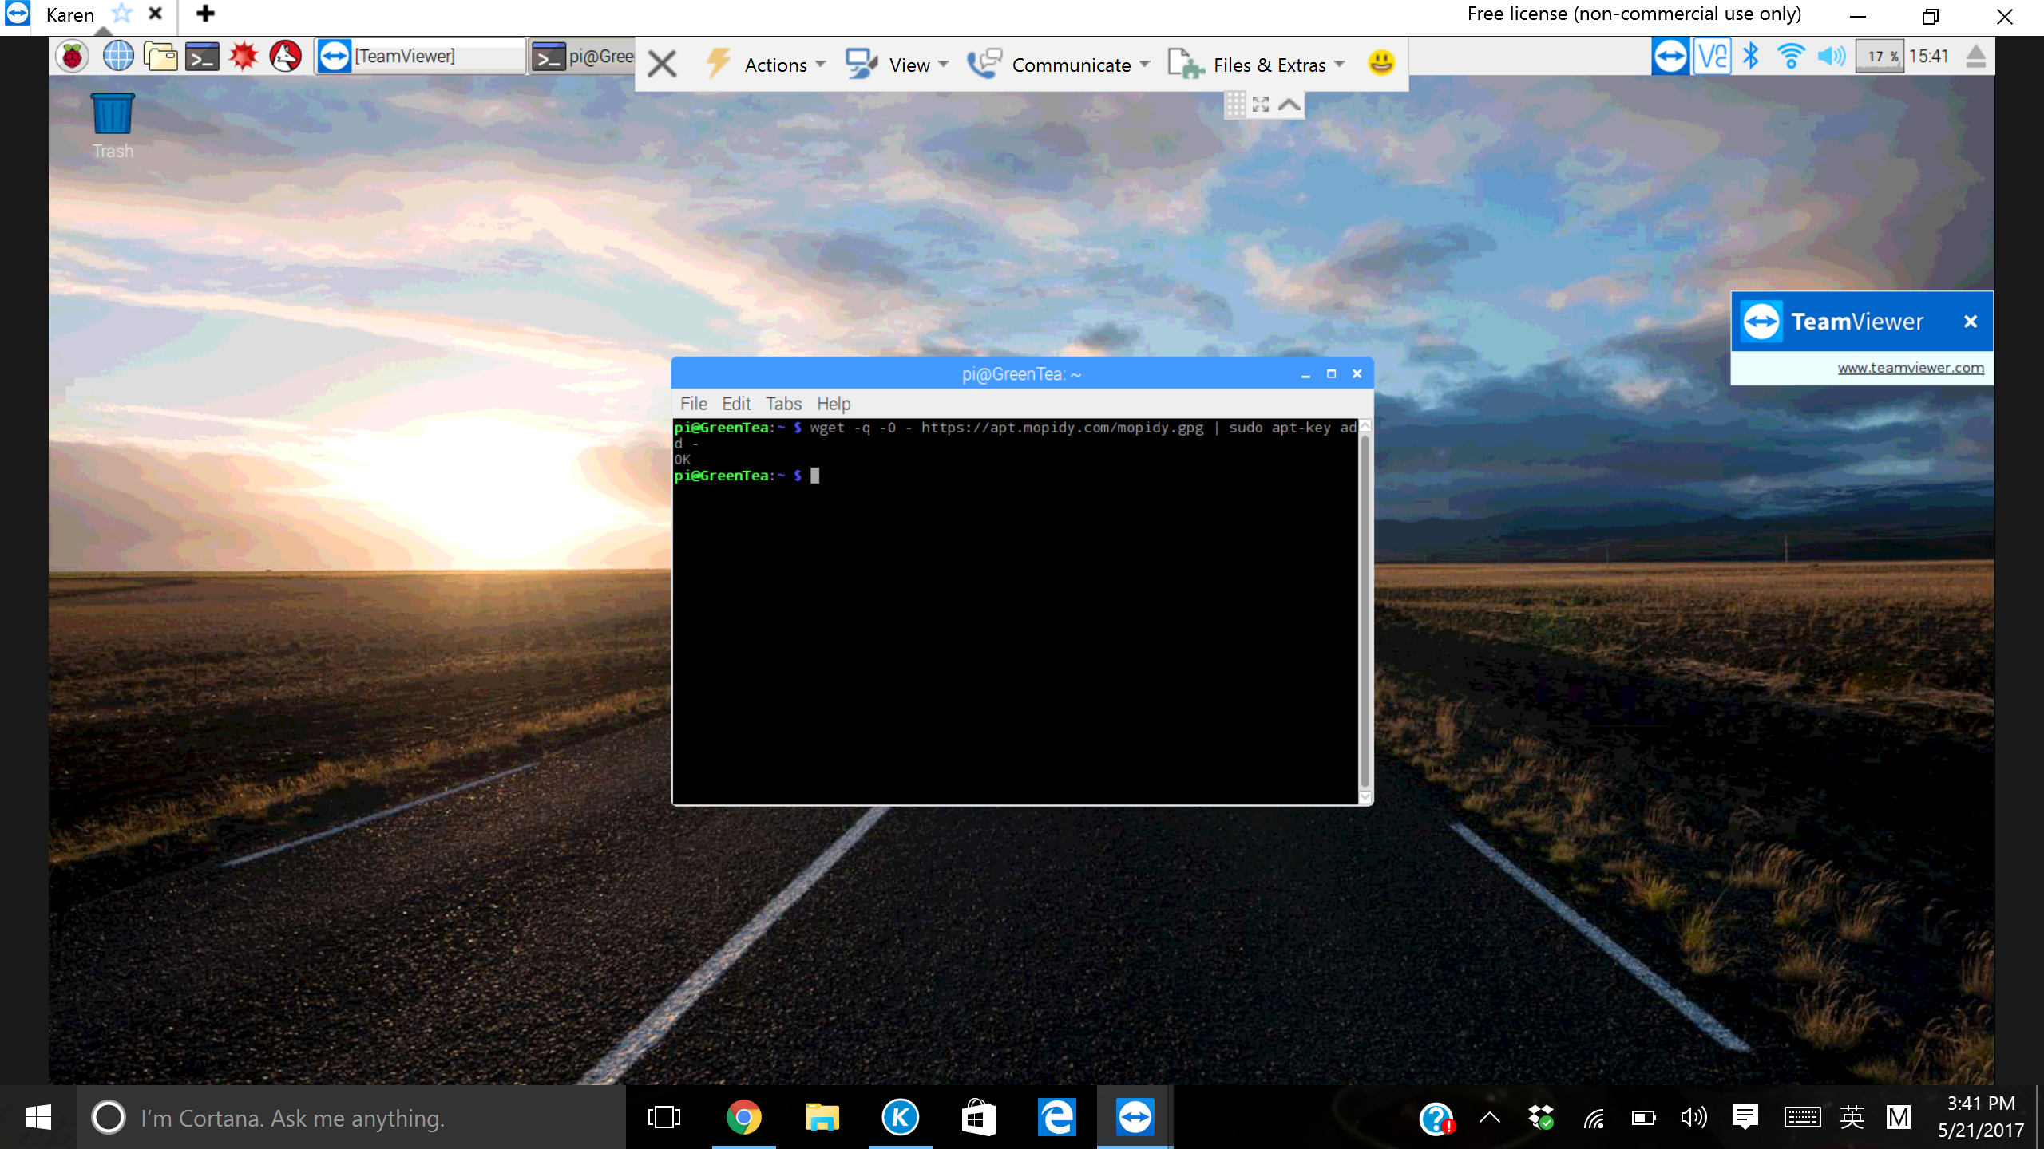

To add the archive’s GPG key:
Add the APT repo to your package sources:

Slide 3
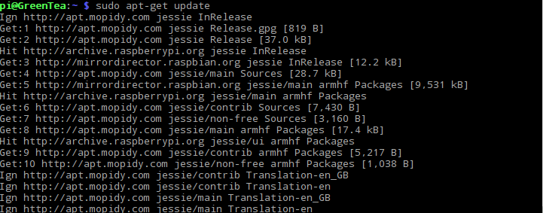
Installing Mopidy and all dependencies: First update pi
Update your rpi, to get it fully
Functioning before you install
Mopidy. (It may cause error if you
Don’t update

Slide 4
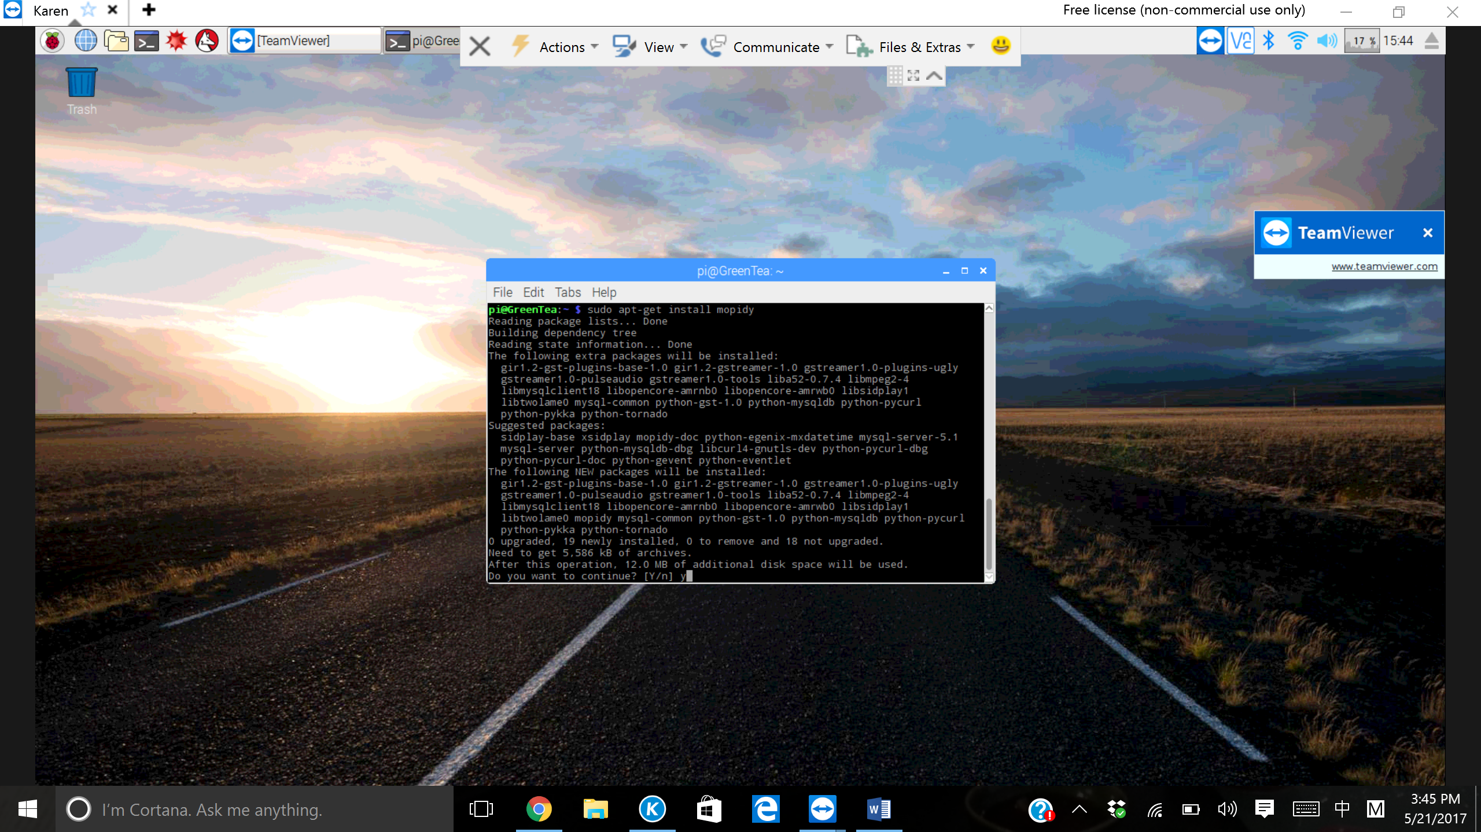
Then install Mopidy:
Official terminal command to get Mopidy.
Command:
“Sudo apt-get install mopidy”.

Slide 5
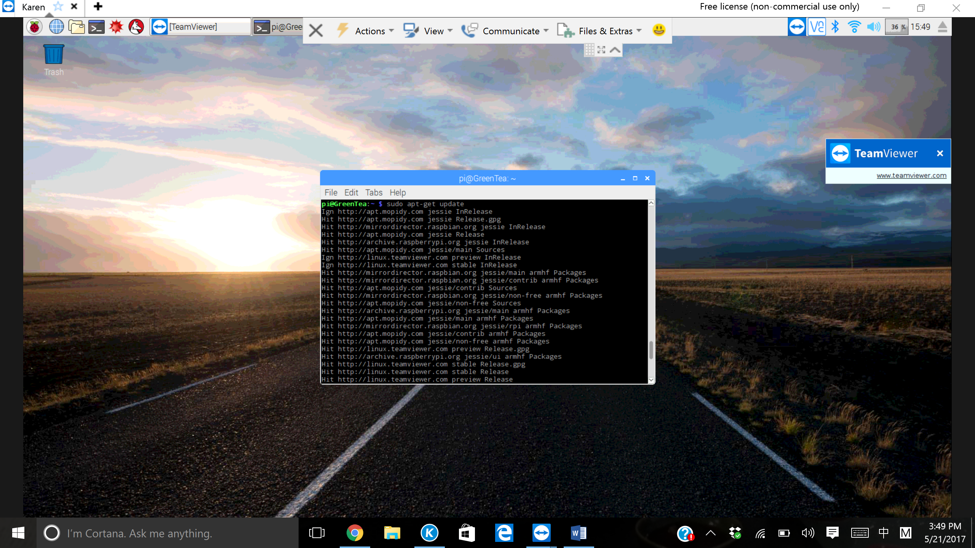
Update Rpi again for the next step:
Updating again will cause
less errors before you run mopidy
or install extensions on mopidy.

Slide 6

Ensure Mopidy is latest version by updating it to a specific command:
Sudo apt-get dist-upgrade not only upgrades for new versions of packages, it handles changing dependencies with new versions of packages. If necessary the ‘dist-upgrade’ command may remove some packages that are less important for the new files.

Slide 7
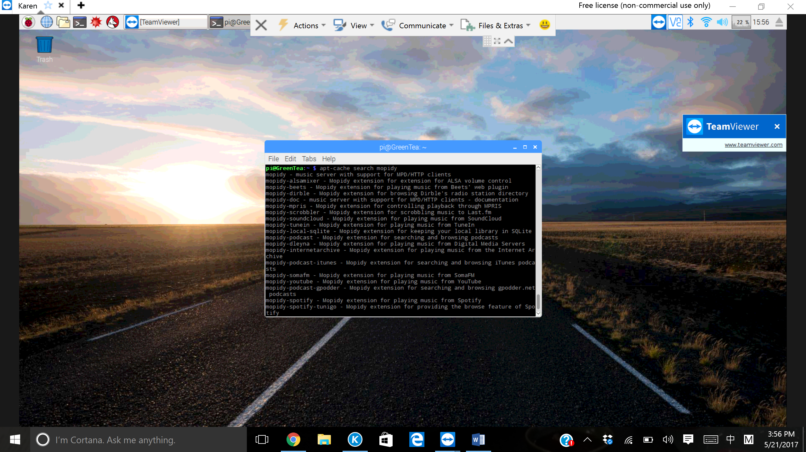
To list all the extensions available from apt.mopidy.com, a list of available extensions are found
While you enter this command, you
will see abundant of extensions that
you can use for your mopidy.
Another command to find more
Extensions will be ‘pip search mopidy’.

Slide 8

For our Music Server, we installed Spotify:
One of our Music Streaming server
That we can install for use.

Slide 9
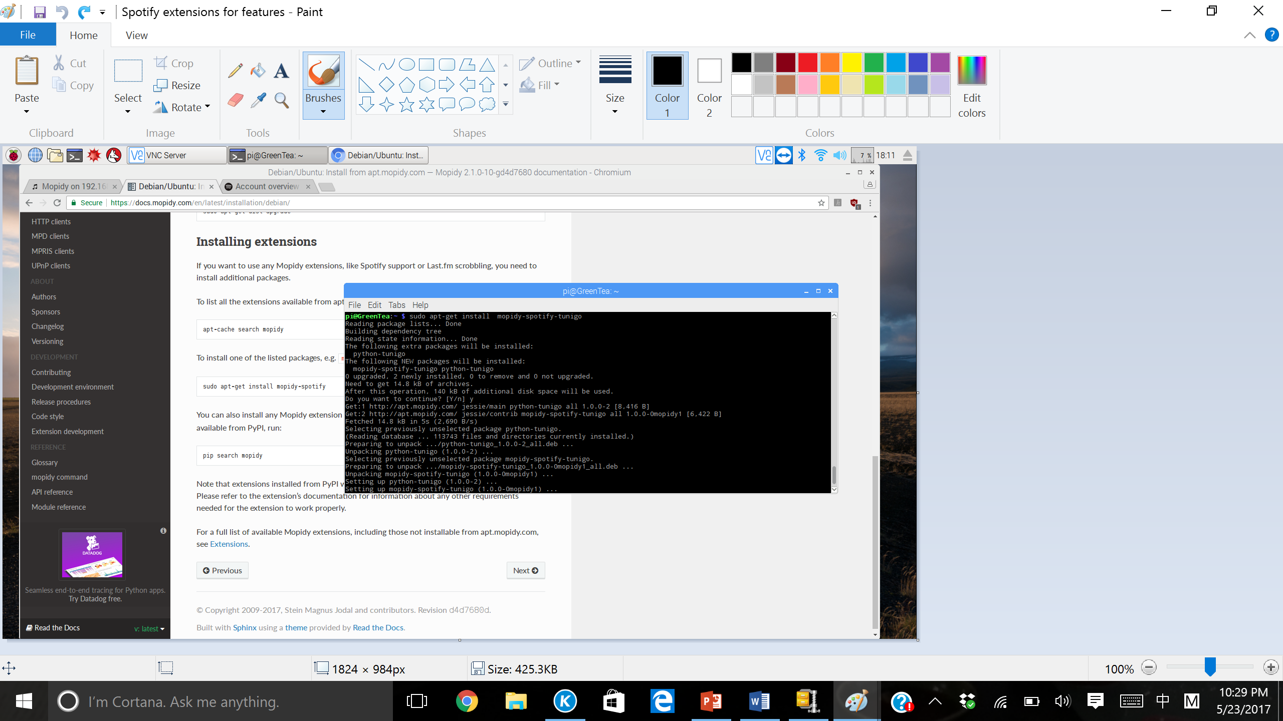
A Spotify feature extension:
Installing Spotify-tunigo extensions for
browsing features on spotify.

Slide 10
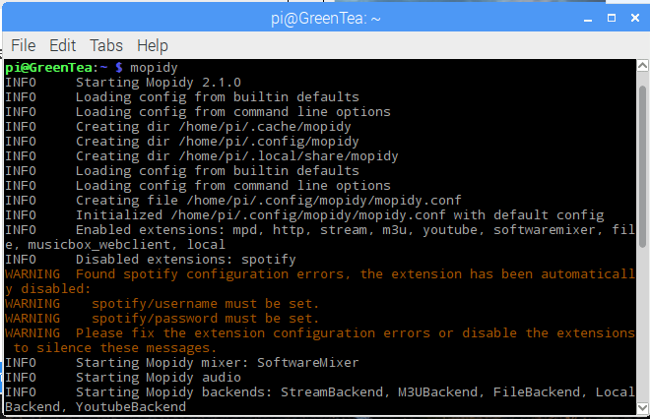
Running Mopidy through terminal
Running Mopidy will start creating
files for us to edit the systems of the
Mopidy itself using
Mopidy configurations.
Enter, ”ctrl-c” to stop mopidy

Slide 11
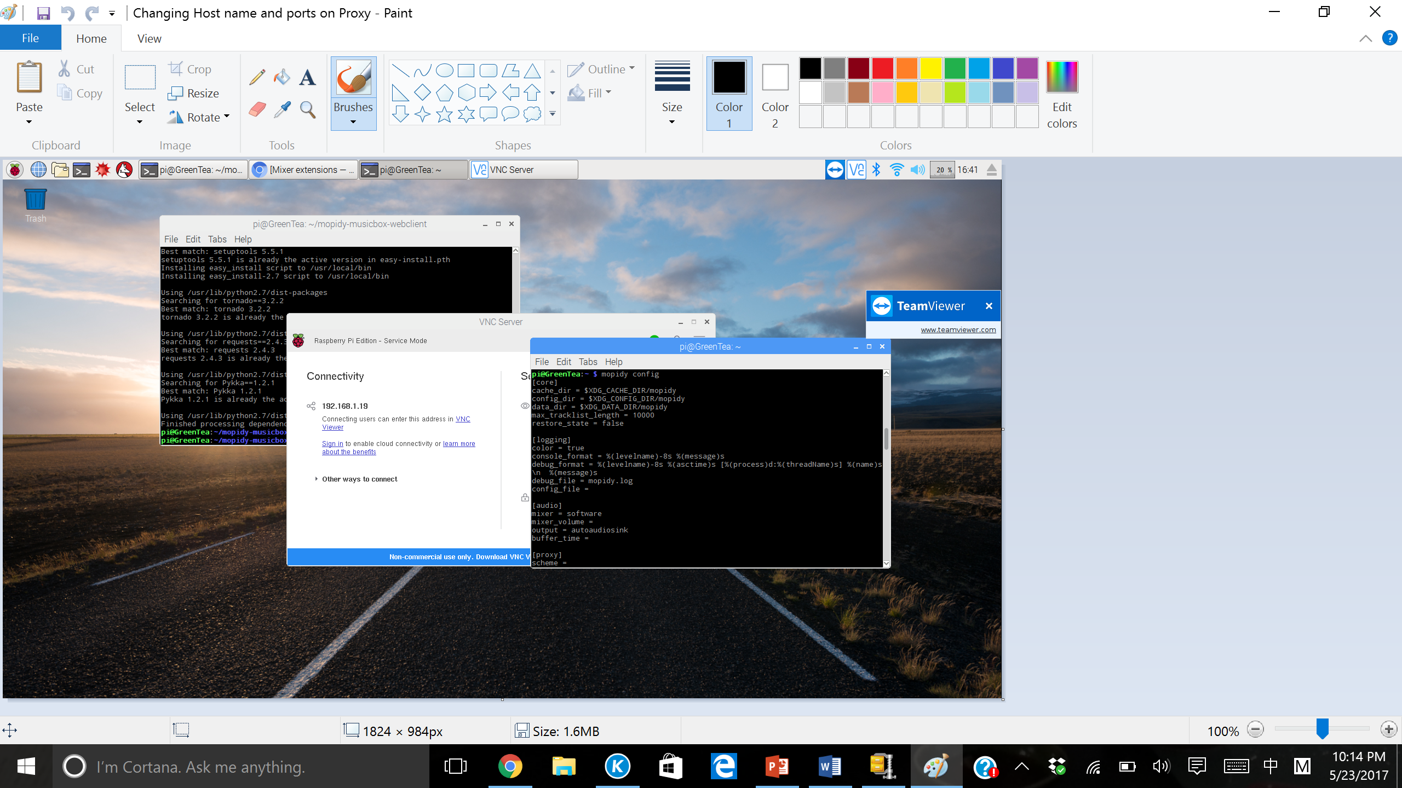

Changing host name and ports on http and mpd ONLY:
Typing in “Mopidy
Config” will show
whether the file has
been created or not.
Once you know if your
files for configuration
Is there, type in
“sudo nano ~/.config/
Mopidy/mopidy.conf”.
This is where you edit
all of your
configurations.
Under http and mpd, change your
hostname to your ip-address.

Slide 12

Configuring Spotify account
Scrolling down to where Spotify is,
you’ll see that you’ll get hashtag
next to username and password,
delete them and then set your
username and password from your
Spotify account.

Slide 13
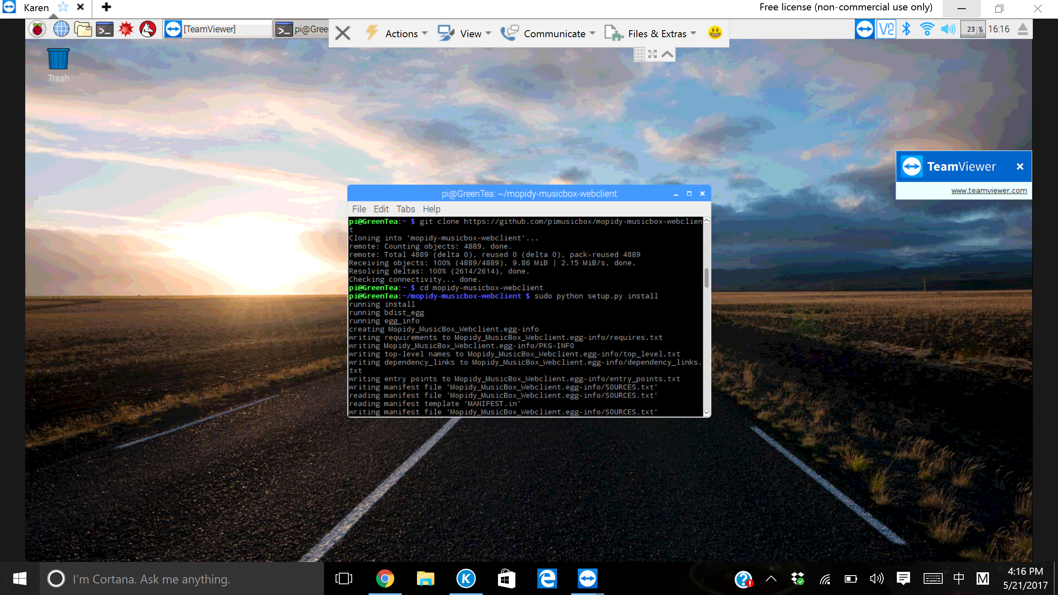
Using git clone to get Mopidy musicbox web client:
Go into the newly downloaded file:

Slide 14

Setups on Web client before you access one.
When your inside the folder for
“/mopidy-musicbox-webclient”,
type in the,”sudo python setup.py
install”. This let your web client gets
setup before you type in your browser to
get inside the web client.

Slide 15
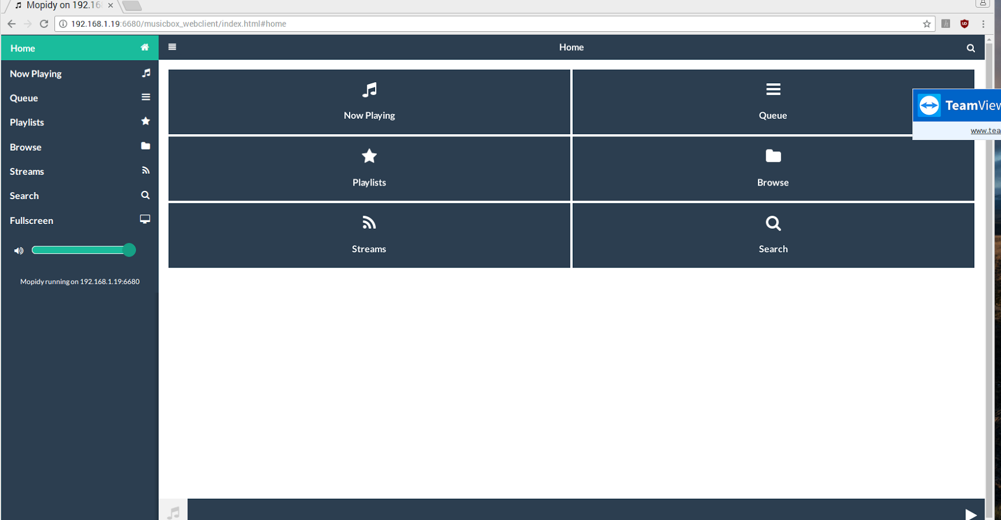
Opening Mopidy on web client:
Open up the browser,
type in your ipaddress and
Port that you used in your
Mopidy configuration.

